Slide 1
FHIM Value Proposition to Stakeholders Version 1.0
9/30/2015
This is a living document, which is intended to evolve.
1

Slide 2
Bottom Line Up Front: FHIM is Instrumental to VA/VistA and DoD/Cerner Modernization Interoperability
Problem: Under utilization of resources impact interoperability
FHIM Objective: To define consistent data and terminology as
Superset of US EHR data and terminology used by Federal Agencies; where,
Information Exchanges are consistent FHIM subsets.
FHIM is a
Composition of EHR related data defined by Federal Agency SMEs
Categorized into clinical domains,
Containing a data dictionary and value sets
Defining data structures, data hierarchies and data associations
Logical Reference Information Model for US health data and terminology
consistent terms, definitions, rules, data structures and value sets for
Conceptual HL7 Reference Information Model (RIM)
EHR and ancillary services systems’ interoperability
Joint Health Information Exchange (HIE) interoperability
VA/VistA-4 and DoD's/Cerner healthcare management systems’ interoperability
9/30/2015
This is a living document, which is intended to evolve.
2

Slide 3
OpenGroup April 2015 “Enhancing HIE with the FHIM” Report
“The Open Group Healthcare Forum commends the FHIM for:
1. The FHIM catalogs a large number of key shared information exchange needs …
2. … based on actual scenarios provided by 20 federal partners …
3. … in a structured model populated with consensus-based industry standards.
4. The FHIM documents the model building processes, which is key to building understanding, confidence, and support.
5. The FHIM enhances automation of healthcare data exchange, thus promoting higher quality and efficiency.
… relating the FHIM to other major efforts to achieve healthcare
interoperability can be an important step in helping to enable
The Open Group vision of Boundaryless Information Flow.”
9/30/2015
This is a living document, which is intended to evolve.
3

Slide 4
FHIM Users and Uses
FHIM is informed by
Federal Partners, including, but not limited to:
VA Information Model
SSA and CMS identity, person and other initiatives
CDC community/public-health initiative
NCI Cancer Informatics Program
FDA Data Standards Program
S&I Framework Initiatives
Federal Standards Committees
CIMI
Standards Organizations, including, but not limited to:
HL7, ASTM,
NCPDP, RxNorm,
HITSP, DICOM,
X12
9/30/2015
This is a living document, which is intended to evolve.
4

Slide 5
FHIM Users and Uses
FHIM informed
VA’s use of NLM Value Set Authority Center (VSAC)
VSAC holds MU value sets and FHIM value sets
VHA Business Information Model updates for VistA Modernization
VistA/CPRS and/or Vista Evolution (VE)/e Health Management Platform (eHMP)
DoD & VA HDS Business Line Work Groups (Recommendation)
4 JIP use cases, is an ideal place for FHIM to serve as a reference information model
DAF-FHIR profile for VA-DOD Health Data Services (HDS) implementation
S&I Framework Community Led Initiative on Public Health Reporting*
FHA sponsored Information Exchange Prototype for Immunization*
Open Group efforts to achieve their vision of boundary less information flow.
* these are ready for follow on work
9/30/2015
This is a living document, which is intended to evolve.
5

Slide 6
FHIM Users and Uses
FHIM informed DHA/MHS Business and Enterprise Architectures
DODAF DIV-1 conceptual data view
Consistent entity names, definitions, relationships
DODAF DIV-2 logical data view
adds consistent attributes, terminology, value sets; where,
interoperability requires venders to have physical schema that conform to DHA’s DIV-2
Mapping of use cases to system objects, components and services
DIV-2 constrained EHR-S FM functions composed into objects and components
DIV-2 constrained Information Model for common services
DIV-2 constrained DAF-FHIR profile for DOD-VA Health Data Services (HDS)
Successful (interoperable) transition of legacy to future-state systems requires:
Legacy physical schemas mapped to DIV-2; and, DIV-2 mapped to future-state systems’
databases, exchanges and viewers
public health surveillance, research
clinical decision support, population health analytics
HIPAA, Meaningful Use stage 2/3, ARRA/HITEC Act and NDAA compliance
9/30/2015
This is a living document, which is intended to evolve.
6

Slide 7
Multiple Models, Multiple Audiences, Multiple Purposes … Model Driven Architecture
Conceptual
FHIM Domains and
Data Dictionary
Logical
FHIM Data/Term.
EHR-S Functions
DAF Queries
COMMUNICATION AND DEFINITION
of business Domains,
concepts and rules
CERTIFIABLE IMPLEMENTATION of business data exchanges and repositories
TESTABLE SPECIFICATION of business objects, services and rules
ICIB
Prioritized Domain
and Capability Lists
Analyst
Architect
DBA
Developer
Physical
NIEM, FHIR,
CCDA etc.
Model Audience Purpose
MDHT
DAF
9/30/2015
This is a living document, which is intended to evolve.
7

Slide 8
Software Development Lifecycle Notional User-Story / Use Case
ICIB Lists prioritize Health Data Sharing (HDS) initiatives; where, the lists inform
Business Use Cases (UCs) developed by Analysts; and, the UCs inform / constrain
System Objects, Capabilities, Services, and Information Exchange Requirements (IERs) described by Analysts and Architects, who are informed by
EHR-S System Functional Model
FHIM, constrained by HL7 Detailed Clinical Models (DCMs) and CIMI
System Logical-Physical Repositories are specified by Architects and Designers, based on
FHIM constrained by the UCs, DCMs and CIMI.
System Information Exchanges are specified by Architects & Designers, based on
Distributed Access Framework (DAF) to obtain required data from Physical Repositories.
FHIM and appropriate Implementation Guides (IGs) to specify data exchanges and
NIST Security Framework, IHE Technical Framework to manage the exchanges.
NIST SP-800 Risk Assessment/Management Framework to manage network risk.
9/30/2015
This is a living document, which is intended to evolve.
8
Notes:
HL7 Clinical Models and CIMI focus on concepts and the necessary meta-data / provenance (who, what, when, where, how) to support specific use cases.
FHIM focuses on domains and the context in which entities, associations and their attributes and value sets exist, based on the Federal Use Cases and SME input.
DAF can use FHIM as its information model to support federated queries.

Slide 9
FHIM as a part of a US Health Model-Driven Architecture (MDA)
Prioritized
Lists
Business
Use Cases
HL7 Clinical Models
CIMI Architypes
Bus iness ||| Technical
EHR System
Functions Model
(Federal) Health
Info. Model
Behavior
Information
Information
Exchanges
Logical-Physical
Repositories
IHE Profiles
HL7 (FHIR, CDA, CCDA, V2) and ASTM, DICOM, NCPDP, X-12, NIEM, etc.
Risk & Security
Framework
9/30/2015
This is a living document, which is intended to evolve.
9

Slide 10
Software Development Lifecycle US Health MDA Users and Uses
Prioritized
Lists
ICIB
use to
inform
Business
Use Cases
Clinical Models
CIMI Architypes
Analysts
create/use to identify functions
inform
Analysts
create/use to identify data
Clinical SMEs
use to constrain
EHR System
Functions Model
Analysts and Architects
define system objects
and capabilities*
(Federal) Health
Info. Model
Analysts and Architects
constrain to specify workflow supported by
Analysts and Designers
constrain to specify data/value sets for
inform
inform
Information
Exchanges
Architects & Designers
specify standard DAF queries,
IHE & NIST Frameworks
Logical-Physical
Repositories
Designers use MDHT
to generate Implementation Guides
inform
inform
IHE Framework
HL7 (FHIR, CDA, CCDA, V2) and ASTM, DICOM, NCPDP, X-12, NIEM, etc.
Developers
implement interoperable exchanges
Testers
certify interoperable exchanges
Risk & Security
Framework
9/30/2015
This is a living document, which is intended to evolve.
10
Notes:
HL7 Clinical Models and CIMI focus on concepts and the necessary meta-data / provenance (who, what, when, where, how) to support specific use cases.
FHIM focuses on domains and the context in which entities, associations and their attributes and value sets exist, based on the Federal Use Cases and SME input.
DAF can use FHIM as its information model to support federated queries.

Slide 11
FHIM Lessons Learned
FHIM is clear, complete, concise, correct, consistent; and,
FHIM can support efficient and effective reuse of Federal Agencies’ wisdom
FHIM as an enhanced resource, must keep pace with and be mapped to
standards (e.g., HL7, SNOMED, NCPDP, RxNorm),
Implementation Resources (e.g., FHIR, CCDA) and
S&I Initiatives (e.g., DAF); and,
Tooling; where, FHIM leverage MDHT to provide implementation guides for developers.
FHIM has a base of users
FHIM is a far better resource, if it is used up front to address data / information gaps
there could be a far greater base of users sharing a common base
Agency S&I Framework projects’ interoperability-goals achievements are accelerated.
reuse eases data exchanges with other organizations & their resources
9/30/2015
This is a living document, which is intended to evolve.
11
Notes:
HL7 Clinical Models and CIMI focus on concepts and the necessary meta-data / provenance (who, what, when, where, how) to support specific use cases.
FHIM focuses on domains and the context in which entities, associations and their attributes and value sets exist, based on the Federal Use Cases and SME input.
DAF can use FHIM as its information model to support federated queries.

Slide 12
Backup
9/30/2015
This is a living document, which is intended to evolve.
12

Slide 13
Key Artifacts/Models Compared-and-Contrasted to FHIM
FHIM focuses on clinical-domains and the superset of entities, associations and their attributes and value set, based on the Federal Use Cases and SME input. FHIM is intended to be constrained to particular applications (e.g., immunization management system/registry).
ICIB Lists and associated Use Cases provide a context for the use of the various models.
HL7 (Detailed) Clinical Models and CIMI Architypes start with clinical concepts (e.g., temperature) and necessary / provenance meta-data needed to support particular use cases.
S&I initiatives have been mapped to FHIM; where for example, an interoperable Data Access Framework (DAF) must be a FHIM subset.
NIEM, FHIR, CDA, CCDA, HL7 V2, NCPDP, HL7 v12 are implementation paradigms; where for interoperability, they must be consistent FHIM sub-sets.
- NIEM, FHIR, CDA, CCDA implementation guides can be generated by MDHT using FHIM
- HL7 V2, NCPDP, X12 are XML messages, which already have implementation guides.
IHE Technical Framework defines specific standards-based systems integration implementations to achieve effective sharing of medical information.
NIST Risk and Security Frameworks establish cybersecurity risk assessments and a structure to create, guide, assess and improve comprehensive cybersecurity programs.
9/30/2015
This is a living document, which is intended to evolve.
13
Notes:
HL7 Clinical Models and CIMI focus on concepts and the necessary meta-data / provenance (who, what, when, where, how) to support specific use cases.
FHIM focuses on domains and the context in which entities, associations and their attributes and value sets exist, based on the Federal Use Cases and SME input.
DAF can use FHIM as its information model to support federated queries.

Slide 14
Acronyms
CDA | Clinical Document Architecture |  | IM | Information Management
CCDA | Consolidated CDA |  | IT | Information Technology
CMS | Centers for Medicare & Medicaid Services |  | JIP | DOD-VA Joint Interoperability Plan
DAF | Data Access Framework |  | MDHT | Model Driven Health Tool
DBA | Database Analyst |  | NIEM | National Information Exchange Model
EHR-S FM | EHR System Functional Model |  | NIST | National Institute of Standards and Technology
FHIR | Fast Healthcare Interoperability Resource |  | NLM | National Library of Medicine
GFI | Government Furnished Information |  | ONC | Office of the National Coordinator
HIT | Healthcare Information Technology |  | S&I | Standards and Interoperability
HHS | Health and Human Services Agency |  | SDO | Standards Development Organization
ICIB | Interagency Clinical Informatics Board |  | SME | Subject Matter Expert
IHE | Integrating the Healthcare Enterprise |  | V2 | HL7 Version 2 Messaging
9/30/2015
This is a living document, which is intended to evolve.
14

Slide 15
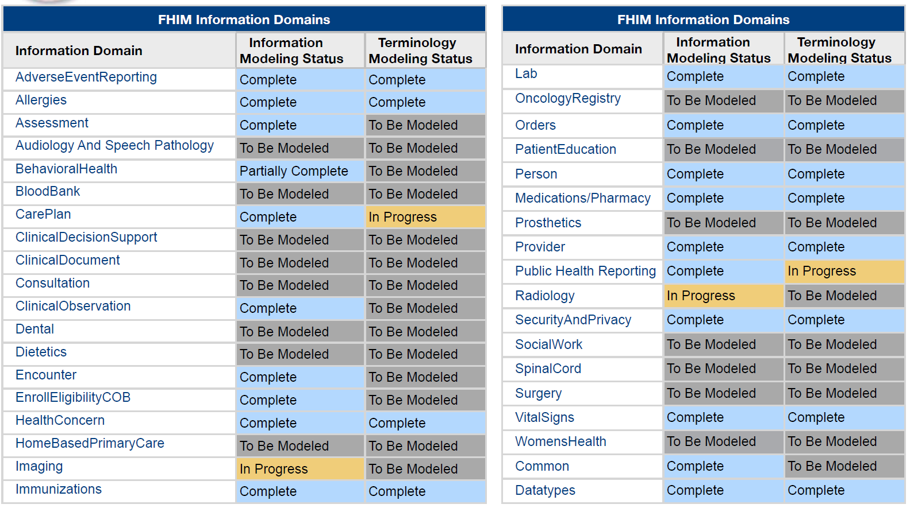
FHIM Information Domains Modelling Status
9/30/2015
This is a living document, which is intended to evolve.
15

Slide 16
Preliminary FHIM PLAN
FY2015 | FY2016 | FY2017 | FY2018+
Case Mgmt. TM | Clinical Decision Support IM-TM (180) | Social Work IM-TM (90) | FHIM & Terminology (TBD)
Radiology/Imaging IM & TM (180) | Consultations IM-TM (180) | Surgery IM-TM (90)
Clinical Decision Support IM-TM (180) | Clinical Documents IM-TM (90) | FHIM & Terminology (TBD)
Clinical Decision Support IM-TM (180) | Social Work IM-TM (90)
FHIM-MDHT (90) | FHIM-MDHT (270) | FHIM-MDHT (TBD) | FHIM-MDHT (TBD)
FHIM-S&I Framework (90) | FHIM-S&I Framework (270) | FHIM-S&I Framework (TBD) | FHIM-S&I Framework (TBD)
US Realm Health Architecture (TBD) | US Realm Health Architecture (TBD) | US Realm Health Architecture (TBD) | TBD
9/30/2015
This is a living document, which is intended to evolve.
16

Slide 17
Questions & Discussion
Is FHIM’s Value Proposition clear?
FHIM Proponents:
Catherine Hoang, VA Proponent
Ian Komorowski, VA Proponent
Nancy Orvis, DHA Proponent
Nona Hall, IPO-Proponent
Paul Tibbits, VA Proponent
FHIM Informed by:
Galen Mulrooney, FHIM Data-Modeling Lead
Jay Lyle, FHIM Terminology-Modeling Lead
Bobbie Peterson, FHIM Program Manager
Steve Wagner, FHIM Project Manager
Steve Hufnagel, FHIM-HL7 Facilitator
Sean Muir, FHIM MDHT-Implementer
Dave Carlson, MDHT Project Lead
Rob McClure, FHIM Clinical-SME
9/30/2015
This is a living document, which is intended to evolve.
17

Slide 18
1) Technical-Messaging / Outreach - Awareness & Understanding what FHIM is HL7 standard as part of US Realm Architecture (Best available resources and tools) 2) Usage / Usability FHIM augmented with MDHT to help implementers 3) How FHIM can evolve … Align FHIM / MDHT with 2015-2016 Federal Health Strategic Plan 2016 Interoperability Standards Advisory (ISA), comments due NLT Nov 6, 2015 FY2016Q1 Federal Health Roadmap, to be released Oct 6, 2015
FHIM Going Forward Strategy
Prepared for:
Gail A. Kalbfleisch Program Director, Federal Health Architecture
Office of the National Coordinator for Health Information Technology
Department of Health and Human Services
Prepared by:
Nona Hall, IPO FHIM Proponent
Steve Wagner, Apprio FHIM Project Manager
Steve Hufnagel, Apprio FHIM Facilitator at HL7
9/30/2015
This is a living document, which is intended to evolve.
18

Slide 19

Proposed US Realm Health Architecture used to operationalize Federal Health initiatives
US Realm EHR-S FM Profile, containing
FHIM
NIEM
FHIR
CDA/CCDA
IHE Technical Framework
HL7 V2
NIST Risk
and Security Framework
NIST HIT Standards and Testing
CMS Meaningful Use
S&I Framework Use-Case Simplification
Tool based
Traceability to
Laws and Regulations
Jurisdictional Policies
Clinical Guidelines
Clinical Pathways
Quality Measures
Implementations
Tests and Certifications
9/30/2015
This is a living document, which is intended to evolve.
19

Slide 20
New S&I Approach
Create Problem Statement & Functional Requirements
Conduct Pilots
Finalize/Select Technical Solution from Pilots sent to SDO(s)
Create/Update/ Publish Standards or IG using SDO Processes & Resources (based of finalized pilot solution)
Engage with SDOs
S&I Support Team + Pilot Community
Year 1 Immunization Pilot
S&I Support Team + Pilot Community + HL7
Year 2-3 DSTU
HL7
Year 4 Ballot
9/30/2015
This is a living document, which is intended to evolve.
20

Slide 21












Mapping of IM Project Models and Tools within the S&I Framework and NIEM Lifecycle
IM Project Models and Tools
Project Use Case mapped to
FHIM Information and Terminology Model
(Data Rqrmnts. Specs.)
FHIM Data and Value Sets for
EHR-S Functions
DAF Queries
NIST Security
Implementation Model
(Design Specs.)
NIEM, FHIR, CCDA, HL7 V2 Implementation Guides
(Build Specs.)
MDHT
Tool
Standards Development
Pilot Demonstration Projects
Use Case Development and Functional Requirements
Harmonization of Core Concepts (NIEM framework)
Implementation Specifications
Reference Implementation
Certification and Testing
Scenario
Planning
NIEM IEPD Lifecycle
9/30/2015
This is a living document, which is intended to evolve.
21

Slide 22
Approach to US Realm Health Architecture aka US Realm EHR-S FM Profile
Model Driven Architecture (MDA)
EHR-S Functional Model as “umbrella”
Traceability to jurisdictional laws, regulations and policies
CMS Meaningful Use objectives and criteria
Traceability to clinical guidelines, pathways and quality measures
S&I Framework Use-Cases Simplification Framework, including
AHIC/HITSP use cases, NIST/CDC immunization use case,
Others as requested by Federal Agencies
Federal Health Information Model (FHIM), with bindings to
NLM’s US Extension to SNOMED CT, LOINC, RxNorm, NCPDP etc.
NIEM, FHIR, CCDA and HL7 V2
HL7 & CIMI detailed clinical models and archetypes
Implementation guides and reference implementations considering
Integrating the Healthcare Enterprise (IHE) Technical Framework
DOD-VA Data Access Framework and Model Driven Health Tool
Healthcare-services platform-independent software-module APIs
NIST Cybersecurity Framework, Standards and Testing
9/30/2015
This is a living document, which is intended to evolve.
22
Notes:
For guidelines see:
www.guidelines.gov managed by AHRQ
NIST IR 7804-1 EHR UI Testing guidelines

Slide 23
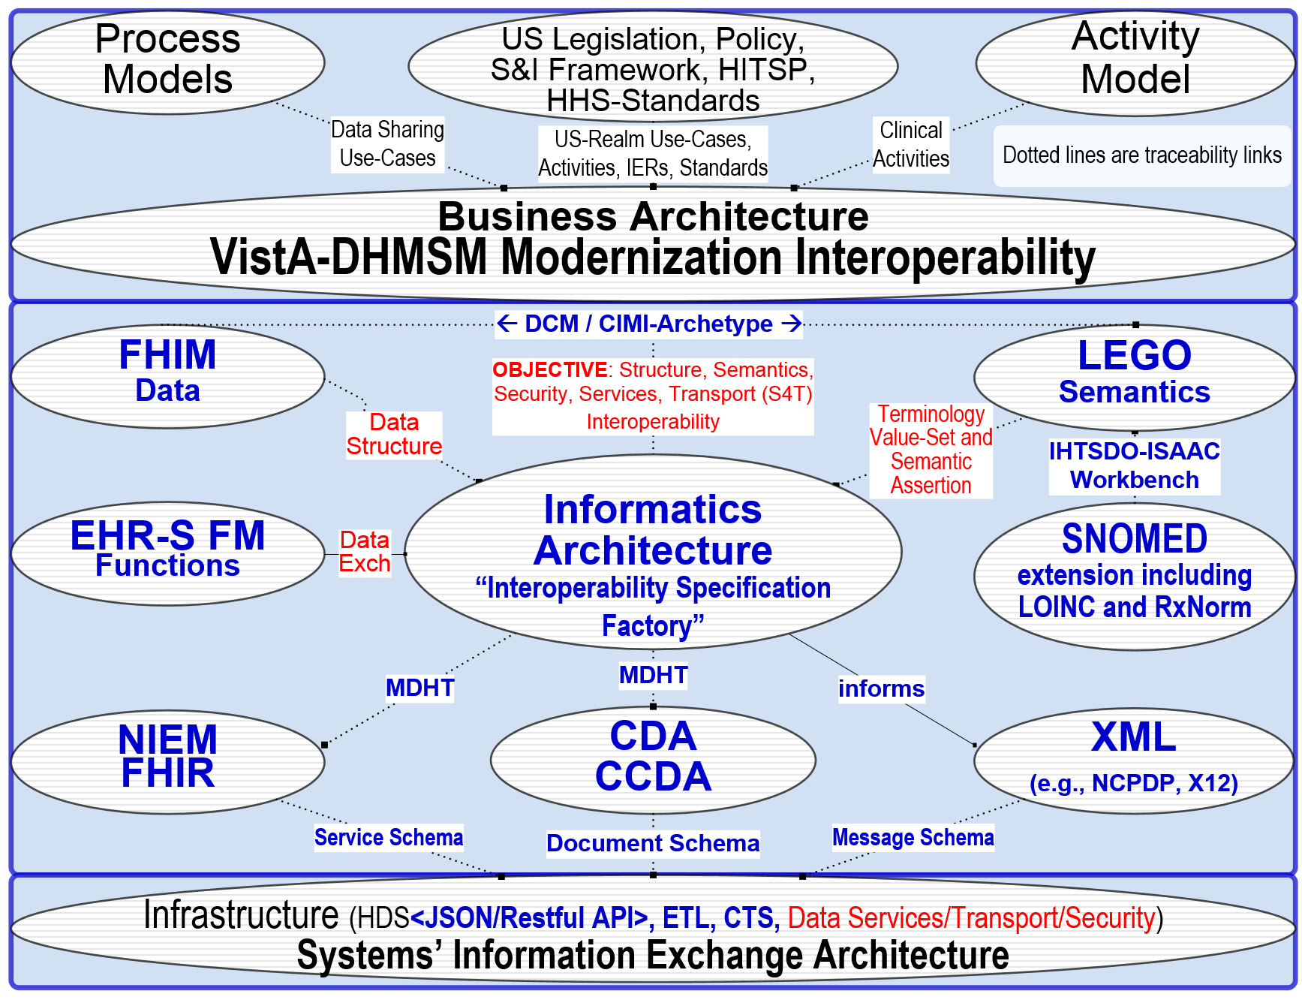
US Realm Health Architecture Informatics View
9/30/2015
This is a living document, which is intended to evolve.
23

Slide 24
Tooling for US Realm Health Architecture aka US Realm EHR-S FM Profile
US Realm Health Architecture in XML/XMI format supporting:
IBM Rational Software Architect, Troux Transformation Platform,
Sparx Enterprise Architect, Open Source Papyrus
Open Health Tools (OHT) Model Driven Health Tool (MDHT)
CDA, CCDA, NIEM, FHIR, HL7 V2 Implementation Guides
NIST sponsored Prometheus Use Case Authoring Tool (UCAT)
Others as requested by Federal Agencies.
9/30/2015
This is a living document, which is intended to evolve.
24

Slide 25
Benefits of US Realm Health Architecture aka US Realm EHR-S FM Profile
US Realm EHR-S FM Profile enhances the national agenda for health IT by
Open and consistent national HIE interoperability via SDO participation
Empowering federal agencies, industry, contractors and academia to efficiently and effectively implement nation-wide solutions for interoperable and secure health information exchange (HIE) that address federal agency business priorities while protecting citizen privacy.
Providing Full Lifecycle Traceability
Clear, complete, concise, correct, consistent model driven arch./design/test/cert.
Consolidated HHS:ONC endorsed HIT artifacts in a freely accessible tool form.
Supporting innovation with open-source development, education, training.
Participation Welcome at HL7 EHR Work Group … You’ll Come
9/30/2015
This is a living document, which is intended to evolve.
25

Slide 26
Proposed HL7 Schedule US Realm EHR-S FM Profile
Sept/Oct 2015 – HL7 Project Scope Statement
Sept/Oct 2016 – HL7 Immunization-Prototype Comments Only Ballot
Sept/Oct 2017 – HL7 Informative Ballot
Sept/Oct 2018 – HL7 Draft Standard for Trial Use (DSTU) Ballot 1
Sept/Oct 2019 – HL7 Draft Standard for Trial Use (DSTU) Ballot 2
Sept/Oct 2020 – HL7 Normative Ballot
9/30/2015
This is a living document, which is intended to evolve.
26

Slide 27
DOD-VA Joint Interoperability Use Cases “Joint Interoperability Plan – DoD/VA Electronic Health Record Systems”
1 Clinical transition of care for patients between organizations - VA must be able to share medical information with one another and with the civilian community to ensure continuity of care. This use case covers the data that must be exchanged between any health system providing care to the same individual, in addition to ensuring common use of national standards and terminology.
2 Service Member separating from military service - All active duty Service Members must receive a comprehensive Separation History and Physical Exam (SHPE) upon separation from military service, and the report of that exam becomes a key component of the Service Treatment Record (STR). The STR is made available to subsequent care providers to support continuity of care and benefits decisions for the patient’s lifetime. This use case applies to all Service Members in all components of the military, whether they retire or separate for other reasons.
3 Wounded warrior involved in the Integrated Disability Evaluation System (IDES) - When a Military Health System (MHS) provider has determined that a Service Member’s medical conditions are permanent and may fall below retention standards, the patient will be referred for Medical Evaluation Board (MEB) processing and the integrated Disability Evaluation System (IDES). When a Veteran or Service Member applies for disability benefits their complete Service Treatment Record must be evaluated.
4 Benefits Adjudication - Service Members undergo the benefits adjudication process with Veterans Benefit Administration. This use case covers Military records from the DoD needed to complete the benefits adjudication process.
9/30/2015
This is a living document, which is intended to evolve.
27

Slide 28
US Realm Health Architecture Directly Supports “Joint Interoperability Plan – DoD/VA Electronic Health Record Systems”
2. DoD/VA Interoperability Technical Objectives
2.1 Standardize Terminology
2.2 Standardize Content Structure
2.3 Standardize Exchange Methods
2.4 Standardize Access
2.5 Design for Flexibility and Modularity
2.6 Protect Privacy and Security
2.7 Compliance with National Standards Organizations
7. Interoperability Challenges
7.1 Terminology Standards
7.2 Transport Standards
7.3 Veterans & Community Health Partner Exchange
7.4 Technical Development
7.5 Impact to Clinical Workflow
Ensuring ubiquitous, standards-based interoperability of health data
across all care settings through an incremental approach.
9/30/2015
This is a living document, which is intended to evolve.
28

Slide 29
US Realm Health Architecture Directly Supports “Federal Health Architecture Strategic Goals”
Strengthening the Federal/National Health IT Landscape
for Improved Health Care and Interoperability
Establish a unified federal voice on health data exchange and interoperability
Establish FHA as a “convener of stature”, and broaden participation
Institutionalize governance decision-making processes
Expand outreach and access to tools
Achieve adoption of interoperability specifications, leading to active data exchange in the Federal health community
Support S&I Framework by providing federal use cases and pilots
Enable FHA partners to move from legacy to new solutions in effective, coordinated manner
Align federal policies in healthcare data exchange
Provide a forum for the cataloging and aligning of federal policies and practices
9/30/2015
This is a living document, which is intended to evolve.
29

Slide 30
US Realm Health Architecture Directly Supports “Federal Health Architecture Roadmap”
Expand, reinvigorate, streamline and operationalize Agency Sponsored artifacts, processes, technologies and products
Harmonize agency duplicative environment while supporting Agencies’ roles, positions and actions
Enhance communication and outreach: make Agency sponsored tools and artifacts more useable, useful and understandable and share nationwide.
Embrace ERH Systems and Public Health Management capabilities as the focal point of technical development of health informatics standards.
Connect to and support the clinicians, an essential FHA community.
Catalyze national Health IT interoperability.
9/30/2015
This is a living document, which is intended to evolve.
30

Slide 31
Data Access Framework: Building Blocks and Scope
DAF Scope: Develop Implementation Guide using standards/profiles for specific use cases
Local (Intra-Organization) access of clinical information from one or more systems
Targeted access of clinical information from a single known external organization
Use cases deal with accessing both data elements (e.g. problems, medications, procedures) and documents (e.g. C-CDA, C32)
DAF Out Of Scope
Trust establishment between organizations for Targeted Query
Discovery of End Points for Targeted Query
Patient Matching rules and algorithms that organizations may implement
Policies that allow/dis-allow disclosure of patient data
Data Model to support queries
FHIM
Result Vocabularies and Value Sets
Query Results
Result Structure
Query Vocabularies and Value Sets
Query Structure
Query Structure
Security Layer
Authentication/Authorization
Application Transport Protocols
Transport Layer
Basic Transport Protocols
Data Access Framework
Building Blocks
9/30/2015
This is a living document, which is intended to evolve.
31

Slide 32
Data Access Framework: Overview
Data Access Framework
Local Access via
Intra-Organization Query
Targeted Access via
Inter-Organization Query
Federated (Distributed) Access across multiple organizations
Create and disseminate queries internal to organization
Query Structure Layer
API’s for Data Access
Authentication/Authorization Layer
Receive standardized responses
Query Results Layer
Create and disseminate queries to single external Organization
Query Structure Layer
Transport Layer
Authentication/Authorization Layer
Receive standardized responses from external orgs
Query Results Layer
Create and disseminate queries to multiple orgs
governed by a network
Receive aggregated or de-identified responses
Focus on Information Model for the network and
Leverage standards from earlier phases.
Data Source
(Org1)
Data Source
(Org2)
Data Source
(Org3)
X Hospital System
X Hospital System
Y Hospital System
Query Request
Query Response
Standards based approach to enable information access at all levels: Local, Targeted, and Federated (Distributed)

Slide 33
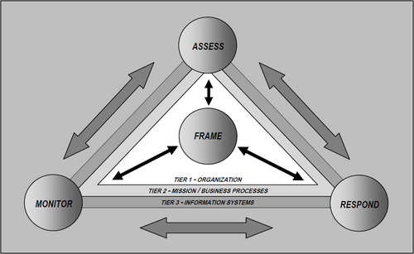
NIST Risk and Security Framework
9/30/2015
This is a living document, which is intended to evolve.
33

Slide 34
History of FHIM so the context of what was started / stalled / restarted; where, it is better appreciated why FHIM kept evolving. (This was thought important from Mark Janczewski and other HL7 Co Chairs since that bigger picture comes into play.
Presented to:
Gail A. Kalbfleisch Program Director, Federal Health Architecture
Office of the National Coordinator for Health Information Technology
Department of Health and Human Services
Prepared by:
Nona Hall, IPO FHIM Proponent
Steve Wagner, Apprio FHIM Project Manager
Steve Hufnagel, Apprio FHIM Facilitator at HL7
9/30/2015
This is a living document, which is intended to evolve.
34

Slide 35
SLIDES TBD
Busch Administration
Tim Cromwell & Nancy Orvis were FHIM Proponents
HITSP Lesson Learned → MDHT for Developers
Obama Administration
9/30/2015
This is a living document, which is intended to evolve.
35

Slide 36
FHA Mission Needs Statement vs. US Realm EHR-S FM Profile
Advance the national agenda for health IT
Facilitate use of HHS mandated standards
rapidly and efficiently implement government-wide solutions for interoperable and secure health information exchange (HIE) that address federal agency business priorities while protecting citizen privacy.
efficient coordination of shared services.
Empower federal agencies’
strategic planning, business analysis and architecture
adoption of nationally-recognized standards and policies for
use of efficient, secure HIE.

Slide 37

FHA Requested Action FHA EHR-S FM Profile
FHA sponsorship under FHIM contract to:
Proceed with HL7 Project Scope Statement
Engage with Agency proponents/stakeholders
Submit periodic articles to
HealthIT.gov Newsletter and FHA The Pulse newsletter
Professional and Trade journals
Participate in HL7, IHE and HIMSS “Connectathons”
Present, promote and “Invite Participation” at professional conferences and otherwise promote
FHA EHR-S FM Profile

Slide 38
Proposed Stakeholders FHA EHR-S FM Profile (Consent Pending)
Sponsor
Gail A. Kalbfleisch Director, Federal Health Architecture,
Proponents
Steven Posnack, Director, ONC Director, Office of Standards and Technology
Nancy Orvis, DHA,
Catherin Hoang, VA,
Nona Hall, IPO
Rob Snelick, NIST
Bob Deaderly, CMS

Slide 39


Model Driven Architecture (MDA) View
Integration of FHIM, NIEM, HITSP and Health SDOs
Federal Health Information Model (FHIM)
Contribute
Data To
Provides
Information
To
Contributes
Data To
HITSP
Contributes
Data To
Open Health Tools (OHT)
UML Tools
Health SDOs
HL7 & Others
Contributes
Process To
NIEM
Contributes
Process To
Produces
Contributes
Process To
XML Schema
IE Documentation
Certification Criteria

Slide 40
S&I Framework
Standards Development
Pilot Demonstration Projects
Use Case Development and Functional Requirements
Harmonization of Core Concepts (NIEM framework)
Implementation Specifications
Reference Implementation
Certification and Testing
Scenario
Planning
NIEM IEPD Lifecycle
Create a NIEM Health standards harmonization process and governance framework
Establish roadmap for existing NHIN standards, MU harmonization, and non-MU health information exchange specifications
Establishes a repeatable, iterative process for developing widely reusable, computable implementation specifications
Establishing the tooling and repositories needed
Establishing the practices and guidelines for modeling
Enables semantic traceability so that useable code can be traced back to original requirements and definitions
Promotes transparency and collaboration from broad range of health stakeholders
18

Slide 41
How the Models/Tools of the IM Project Support the S&I Framework
Direct engagement of the Federal partner community
Support for Federal partner priorities such as VLER and MU
Direct support of Federal partner use cases
Adoptable by all organizations - models and tools are freely available
Traceability to the use cases and functional requirements supported
Provides semantic and syntactic modeling constructs to support the definition of information
Harmonizes standards across the Federal partners and standards organizations

Slide 42
How the Models/Tools of the IM Project Support the S&I Framework
Able to integrate with and support the NIEM process
Supports the 3 OMG/MDA model abstractions - CIM, PIM, PSM
FHIM content derived from CIMs
FHIM model is a PIM
PSM produced by MDHT
MDHT tools can produce multiple technology bindings (PSMs) for the same set of logical specifications
MDHT tools can generate certification/testing artifacts

